Slide 1
A representation of trade and shipping networks in global energy models
Author: Jun Ukita Shepard (ENE)
Supervisors: Bas van Ruijven, Behnam Zakeri
ENE-YSSP Midterm Presentations (2019)

Slide 2
Methods Overview
Research questions:
1: Do energy trajectories change when we include dynamic shipping costs?
2: How do trade networks adapt to projected energy trajectories?
Short-term goal:
Represent bilateral trade in MESSAGEix

Slide 3
Global pool → bilateral trade in MESSAGEix Methods
“Global Pool” Schema:
PRIMARY
EXPORT
EXPORT/IMPORT
SECONDARY
crudeoil
crudeoil
crudeoil
crudeoil
crudeoil
crudeoil
AFR
Input
oil_exp
Output
GLB
GLB
Input
oil_trd
Output
GLB
GLB
Input
oil_imp
Output
WEU
node_loc
node_loc
node_loc
AFR
GLB
WEU
Legend:
Level (e.g. primary)
Node (e.g. R14_RUS)
Commodity (e.g. crude oil)
Technology (e.g. oil_exp)
Parameter (e.g. input)

Slide 4
Global pool → bilateral trade in MESSAGEix Methods
“Bilateral Trade” Schema:
PRIMARY
PIPED-GAS
SECONDARY
gas
gas_weu
gas_weu
gas
AFR
Input
gas_exp_weu
Output
GLB
GLB
Input
gas_imp
Output
WEU
node_loc
node_loc
AFR
WEU
Legend:
Level (e.g. primary)
Node (e.g. R14_RUS)
Commodity (e.g. crude oil)
Technology (e.g. oil_exp)
Parameter (e.g. input)

Slide 5
Methods Overview
Estimate shipping distances
Create dataset of key trade variables
Regional aggregation of data
Translate to a premium (i.e. cost)
1
Parameterize trade and shipping networks
Convert trade of key energy commodities from “global pool” schema to “bilateral trade” schema
2
Re-parameterize MESSAGE global model
Based on historical impacts of key variables (1b), create scenarios (e.g. high sanction)
Run scenarios in MESSAGE and compare
3
Run and compare trade scenarios
Notes:
Prior to IIASA and in the first week, I compiled trade data and validated it with IEA values

Slide 6
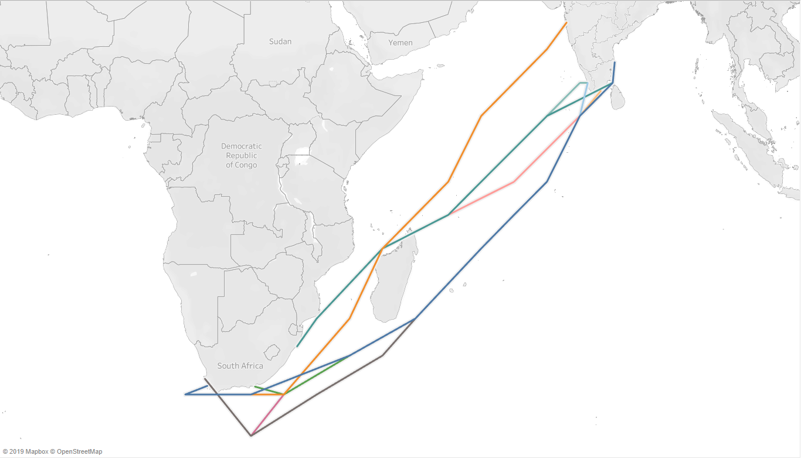
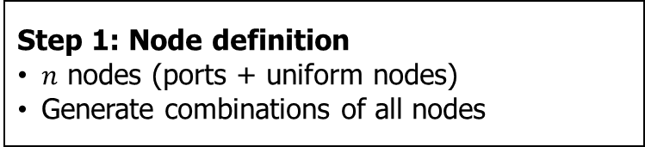
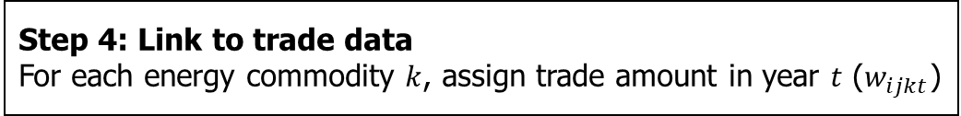
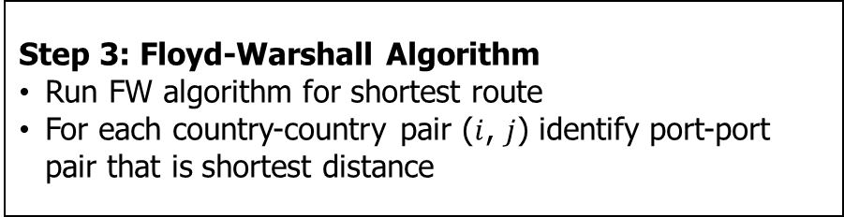
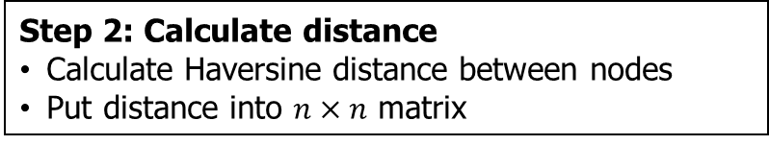
Estimating bilateral distance Methods
Step 1: Node definition
$n$ nodes (ports + uniform nodes)
Generate combinations of all nodes
Step 2: Calculate distance
Calculate Haversine distance between nodes
Put distance into $n×n$ matrix
Step 3: Floyd-Warshall Algorithm
Run FW algorithm for shortest route
For each country-country pair ($i$, $j$) identify port-port pair that is shortest distance
Shortest paths between South Africa and India
Step 4: Link to trade data
For each energy commodity $k$, assign trade amount in year $t$ ($w_{ijkt}$)

Slide 7

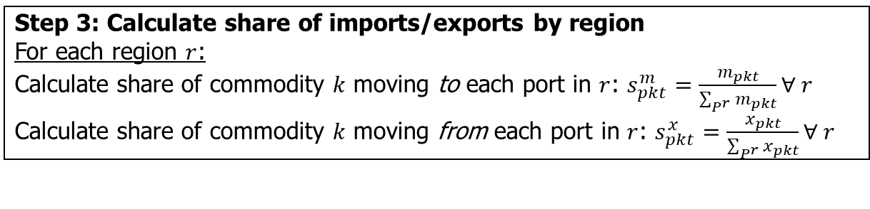
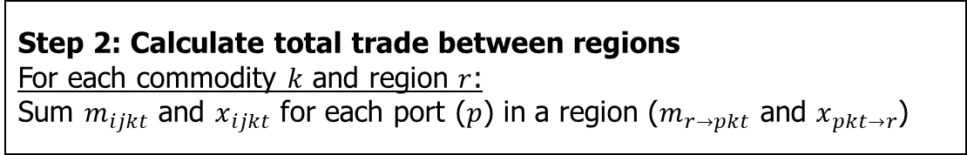
Aggregating distance to regional level Methods
Step 1: Assign trade to port
For each commodity $k$:
Assign trade amount in year $t$ ($m_{ijkt}$ for imports, $x_{ijkt}$ for exports) to each port-port combination
Step 2: Calculate total trade between regions
For each commodity $k$ and region $r$:
Sum $m_{ijkt}$ and $x_{ijkt}$ for each port ($p$) in a region ($m_{r→pkt}$ and $x_{pkt→r}$)
Step 3: Calculate share of imports/exports by region
For each region $r$:
Calculate share of commodity $k$ moving to each port in $r$: $s_{pkt}^{m}=\frac{m_{pkt}}{\sum_{P^{r}}{m_{pkt}}}∀ r$
Calculate share of commodity $k$ moving from each port in $r$: $s_{pkt}^{x}=\frac{x_{pkt}}{\sum_{P^{r}}{x_{pkt}}}∀ r$
Step 4: Identify primary ports by region
For each region $r$:
The port with the largest $s_{pkt}^{m}$ and $s_{pkt}^{x}$ are the primary import/export port for region $r$ in year $t$ for commodity $k$
Notes:
In the first stage, we assigned a port-port combination to each country-country combination
We link this to trade data, so now for each commodity, we have the port-port combination associated with bilateral trade
We aggregate trade up to the region level (like WEU), which is a user specified aggregation

Slide 8
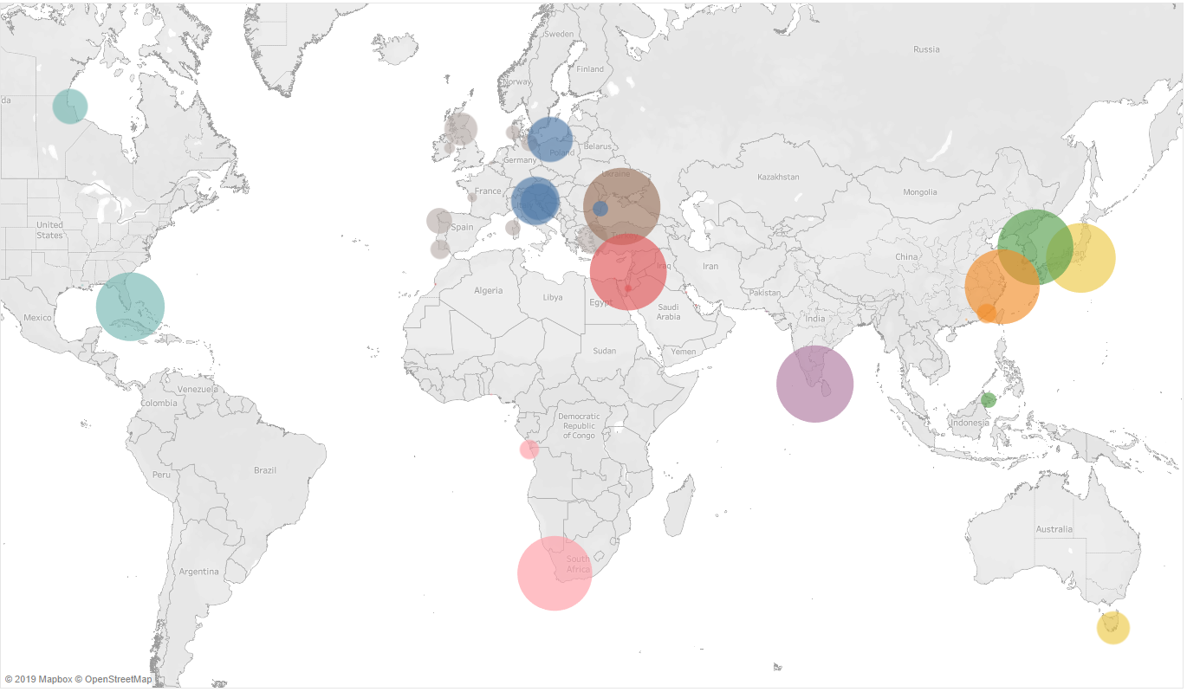
Aggregating distance to regional level Results
Ports by importing region: Coal from Latin America (LAM) in 2013

Slide 9
Other trade variables Data
In addition to distance:
Trade amount ($ and tons)
Gravity terms: GDP, population, common language, etc.
War and minor conflict
Trade sanctions: threatened, imposed, resolved
Embodied war, conflict, trade sanctions
…identified at the exporter-importer-year level
Notes:
Sources:
Gravity terms: World bank
Trade sanctions: US ITC, literature review
Conflict: Uppsala Conflict Data Programme
Trade: BACI

Slide 10
Global pool → bilateral trade in MESSAGEix Technologies of interest
gas_exp_afr
coal_exp_afr
lh2_exp_afr
Natural gas
(piped)
…
Coal
…
Liquid H2
…
gas_exp_weu
coal_exp_weu
lh2_exp_weu
lng_exp_afr
loil_exp_afr
meth_exp_afr
LNG
…
Light oil
(petroleum)
…
Methanol
…
lng_exp_weu
loil_exp_weu
meth_exp_weu
foil_exp_afr
oil_exp_afr
Fuel oil
(petroleum)
…
Crude oil
eth_exp_afr
…
Ethanol
…
foil_exp_weu
oil_exp_weu
eth_exp_weu
22 parameters converted from global pool → bilateral trade schema
5 trade technologies (e.g. crude oil) → 70 region-specific technologies

Slide 11
Translating variables to premiums Methods
We can represent effects of distance (and other variables) in MESSAGE through the variable cost parameter
Compile trade dataset:
N = 223,717
Years: 1995-2014
Uniquely identified by energy commodity-importer-exporter-year
Run regression for gravity model:
For all regions
By region, to capture heterogeneity in sensitivity to variables of interest
Notes:
For translating the effect of variables, we do not worry about regional aggregation (yet)

Slide 12
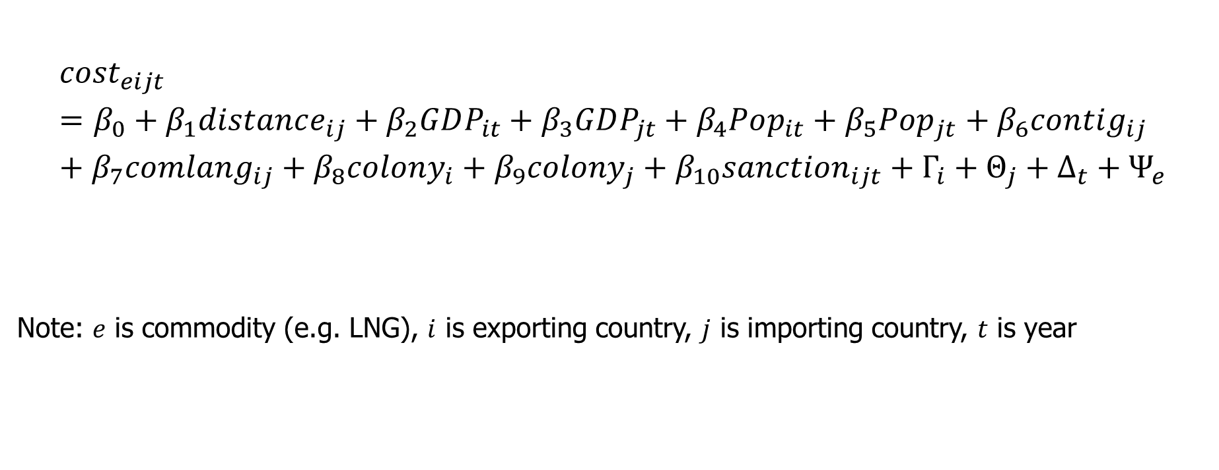
Translating variables to premiums Methods
$${cost}_{eijt}=β_{0}+β_{1}distance_{ij}+β_{2}GDP_{it}+β_{3}GDP_{jt}+β_{4}Pop_{it}+β_{5}Pop_{jt}+β_{6}contig_{ij}+β_{7}comlang_{ij}+β_{8}colony_{i}+β_{9}colony_{j}+β_{10}sanction_{ijt}+Γ_{i}+Θ_{j}+Δ_{t}+Ψ_{e}$$
Note: $e$ is commodity (e.g. LNG), $i$ is exporting country, $j$ is importing country, $t$ is year

Slide 13
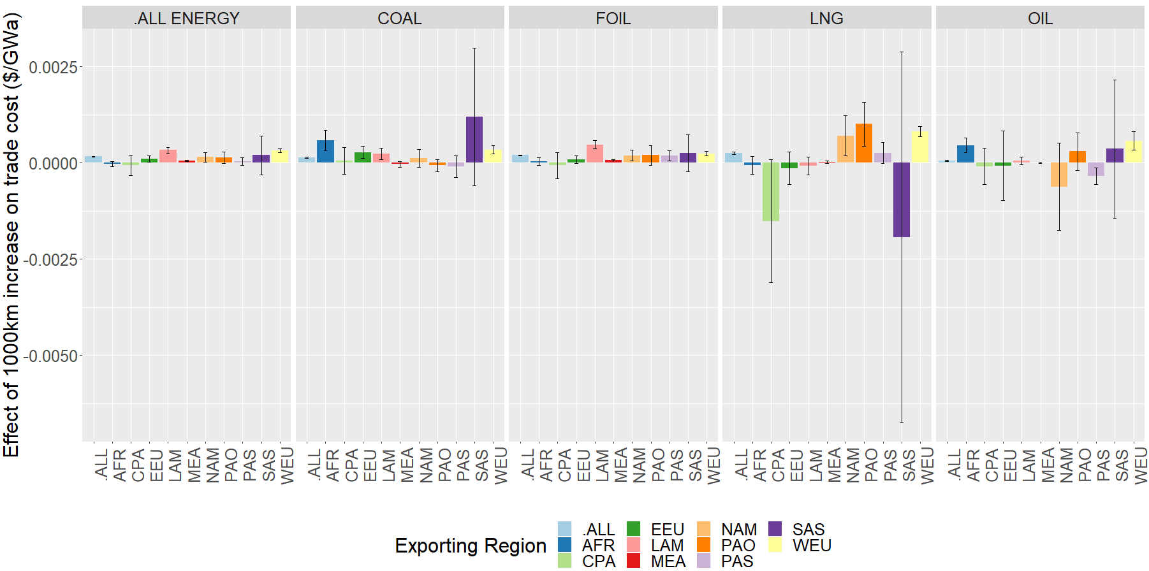
Parameterizing trade through variable costs Results
Effect of distance on trade cost, error bars represent 95% confidence

Slide 14
Parameterizing trade through variable costs Results
Takeaways:
Distance has a significant effect overall
Distance matters for some fuels (e.g. LNG) more than others (e.g. coal)
There is too much uncertainty in heterogeneity by region
Probably best to use a distance effect that is:
Constant across regions
Varies by energy type
Effect of distance on trade cost, error bars represent 95% confidence

Slide 15
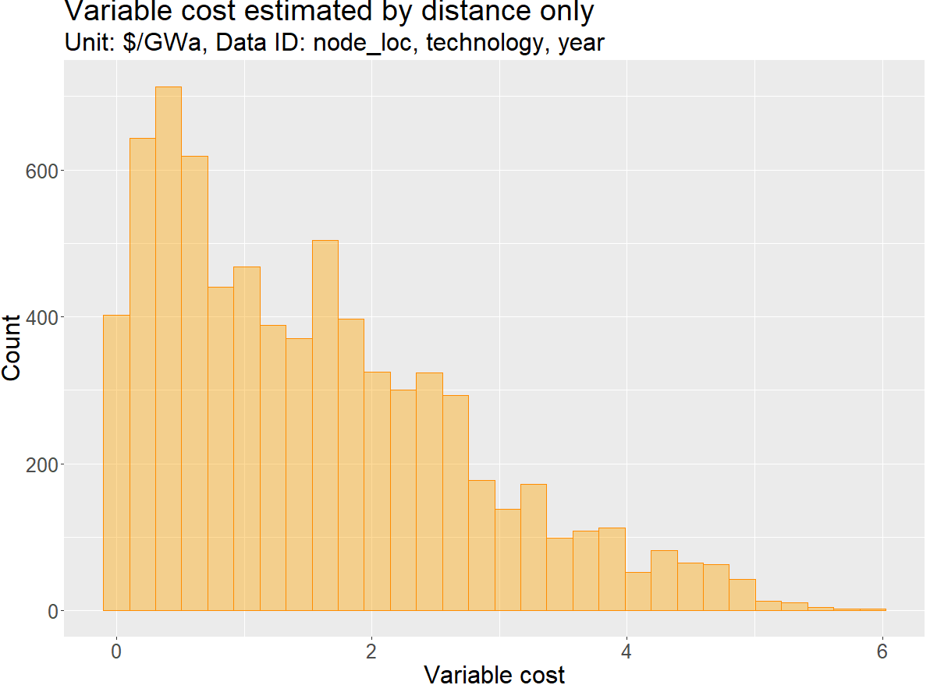

Parameterizing trade through variable costs Results
$varcost_{r_{1}r_{2}kt}=β_{1}×distance_{r_{1}r_{2}kt}$
…so variable cost still varies by regions,
commodity, and year

Slide 16
PS: Keeping things flexible How?
Allow the following to be user-defined:
Major trading ports by country
Node granularity in distance calculation
Regional aggregation (country to region mapping)
MESSAGEix parameter values for bilateral trade

Slide 17
Challenges and questions
Is the regional aggregation method necessary or can it be simplified?
How can commodities that are not represented in bilateral trade data be used?
How should technical lifetime be addressed for export technologies?
I’m not allowing technologies to vintage

Slide 18
Appendix

Slide 19
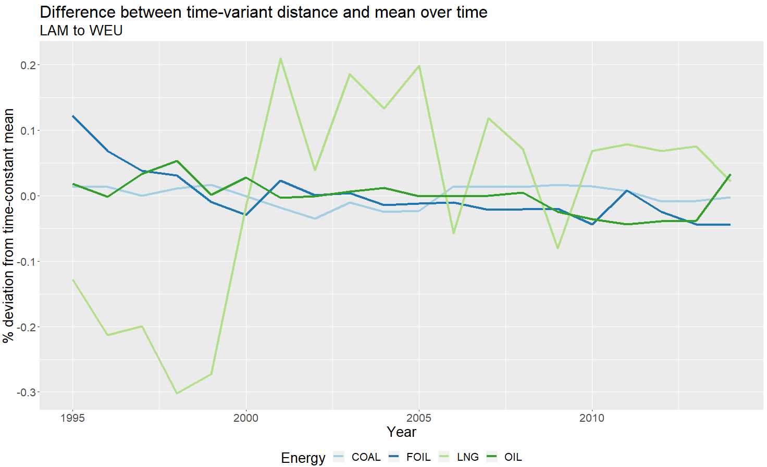
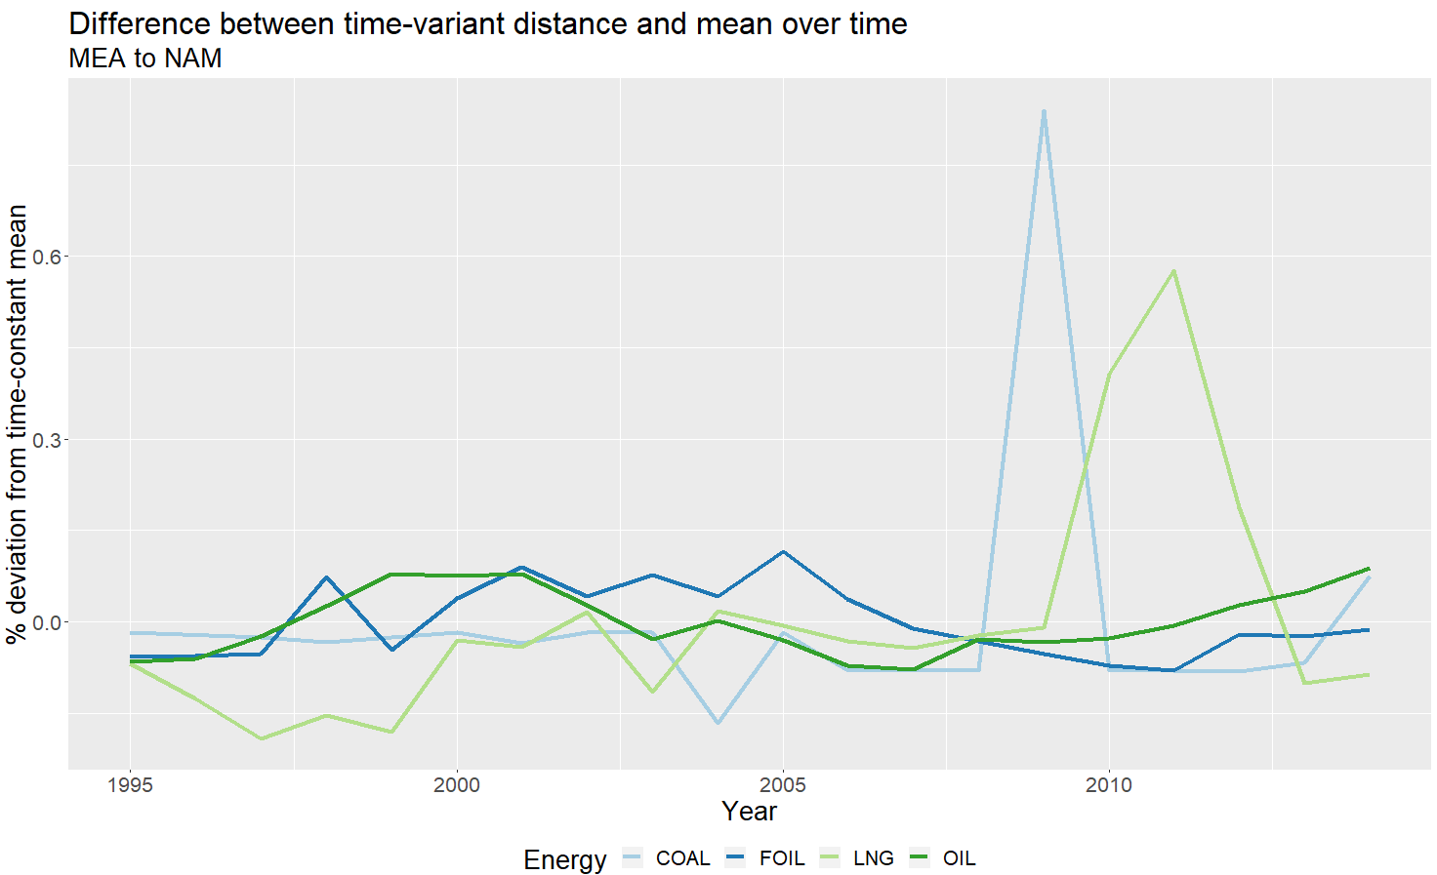
Why allow time-variant distance?
Trade-weighted distance changes over time

